Slide 1

Analyzing Exam Stress Dataset
PYTHON HACKATHON
Maya Ravichandran
12/12/2023
Notes:
Welcome, everyone!
We're excited to present our findings from a one-week hackathon, where we applied our technical coding skills to analyze the impact of exam stress on students. Our team—Bushra, Kavya, Maya, Sujitha, and myself Garima —has worked diligently to extract meaningful insights from complex data.
Lets dive in.

Slide 2


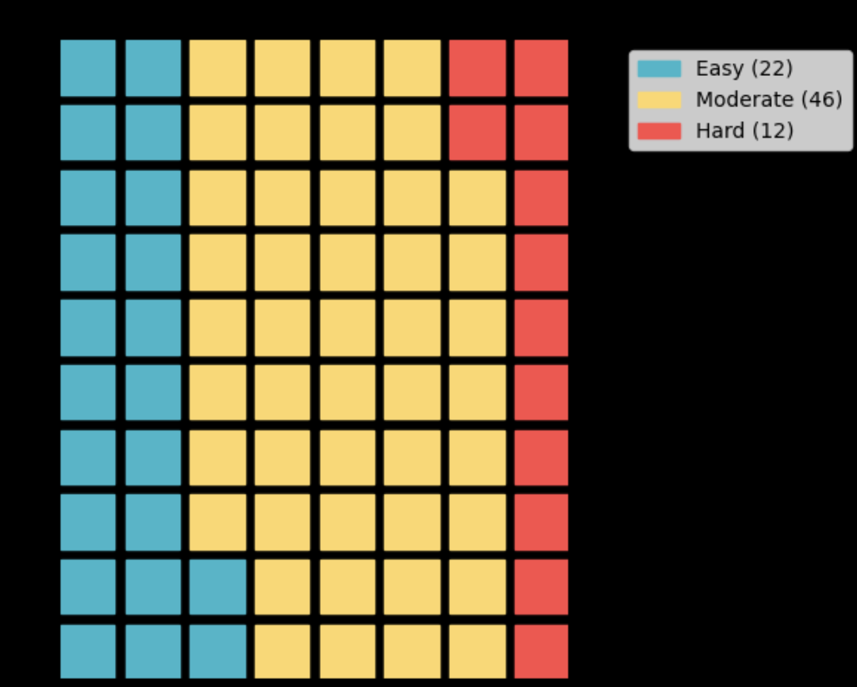
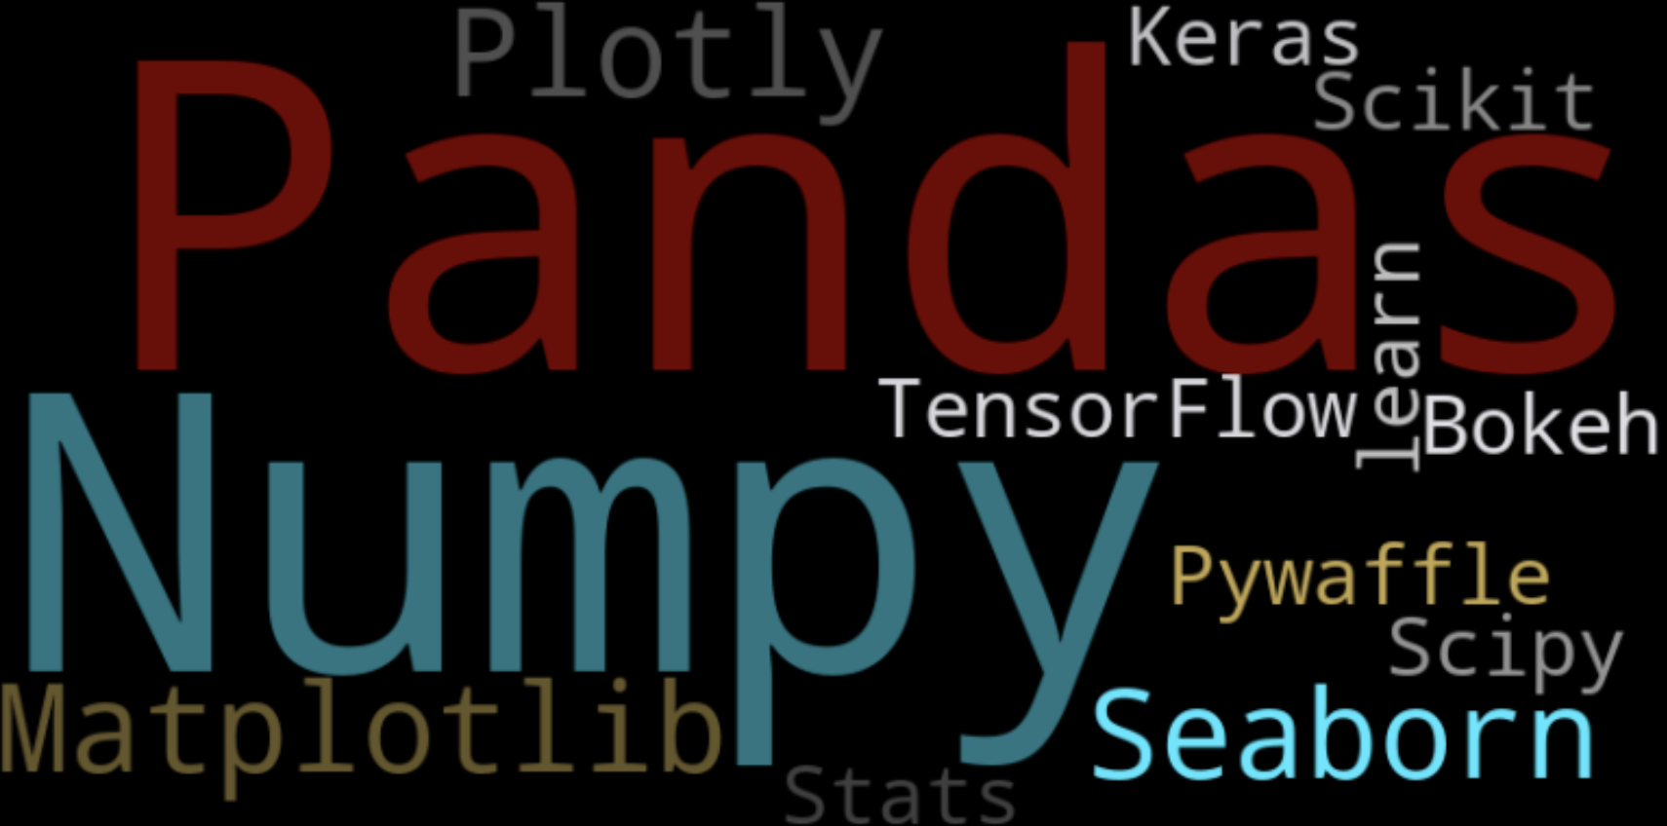
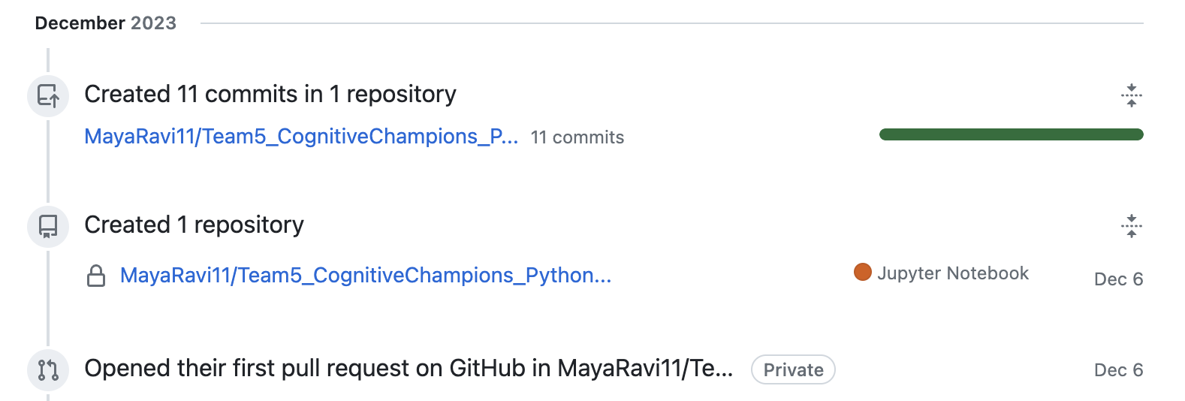
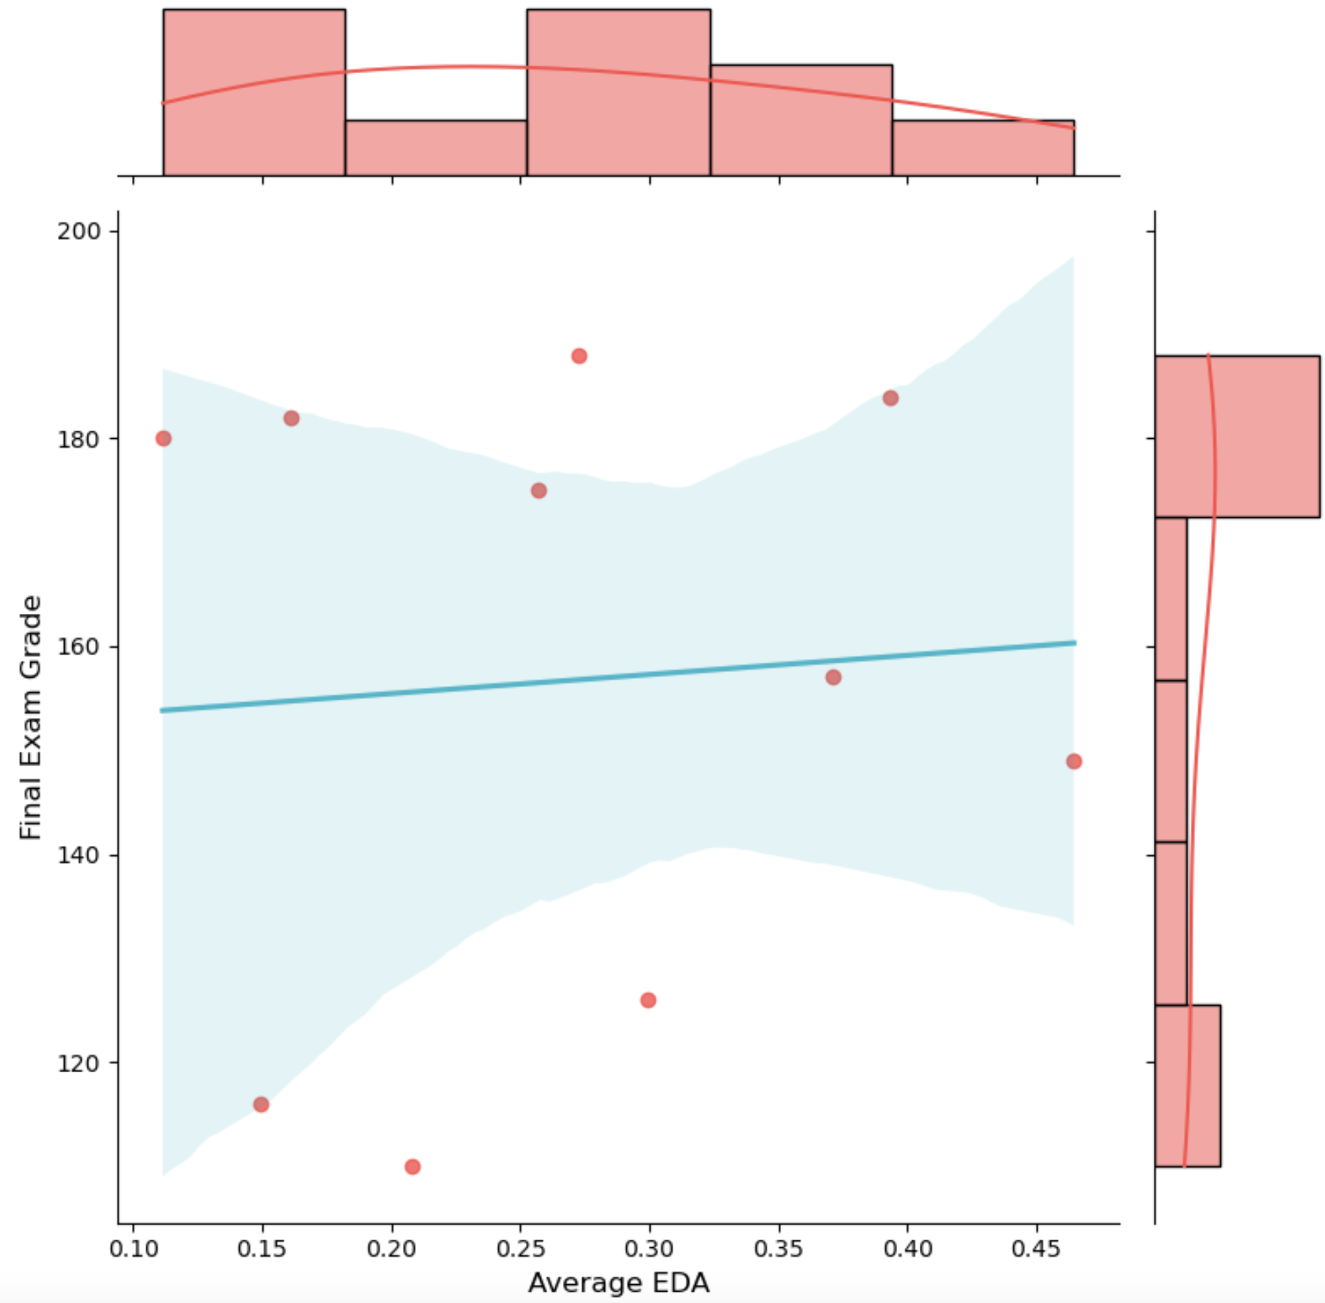
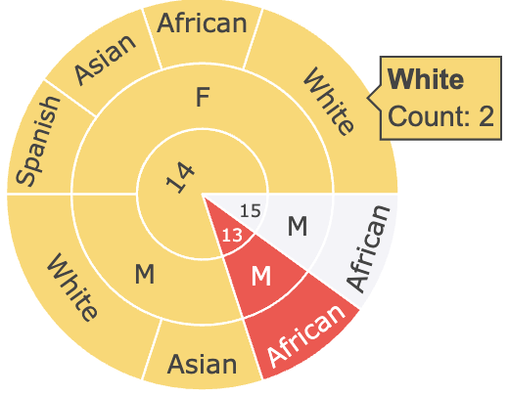
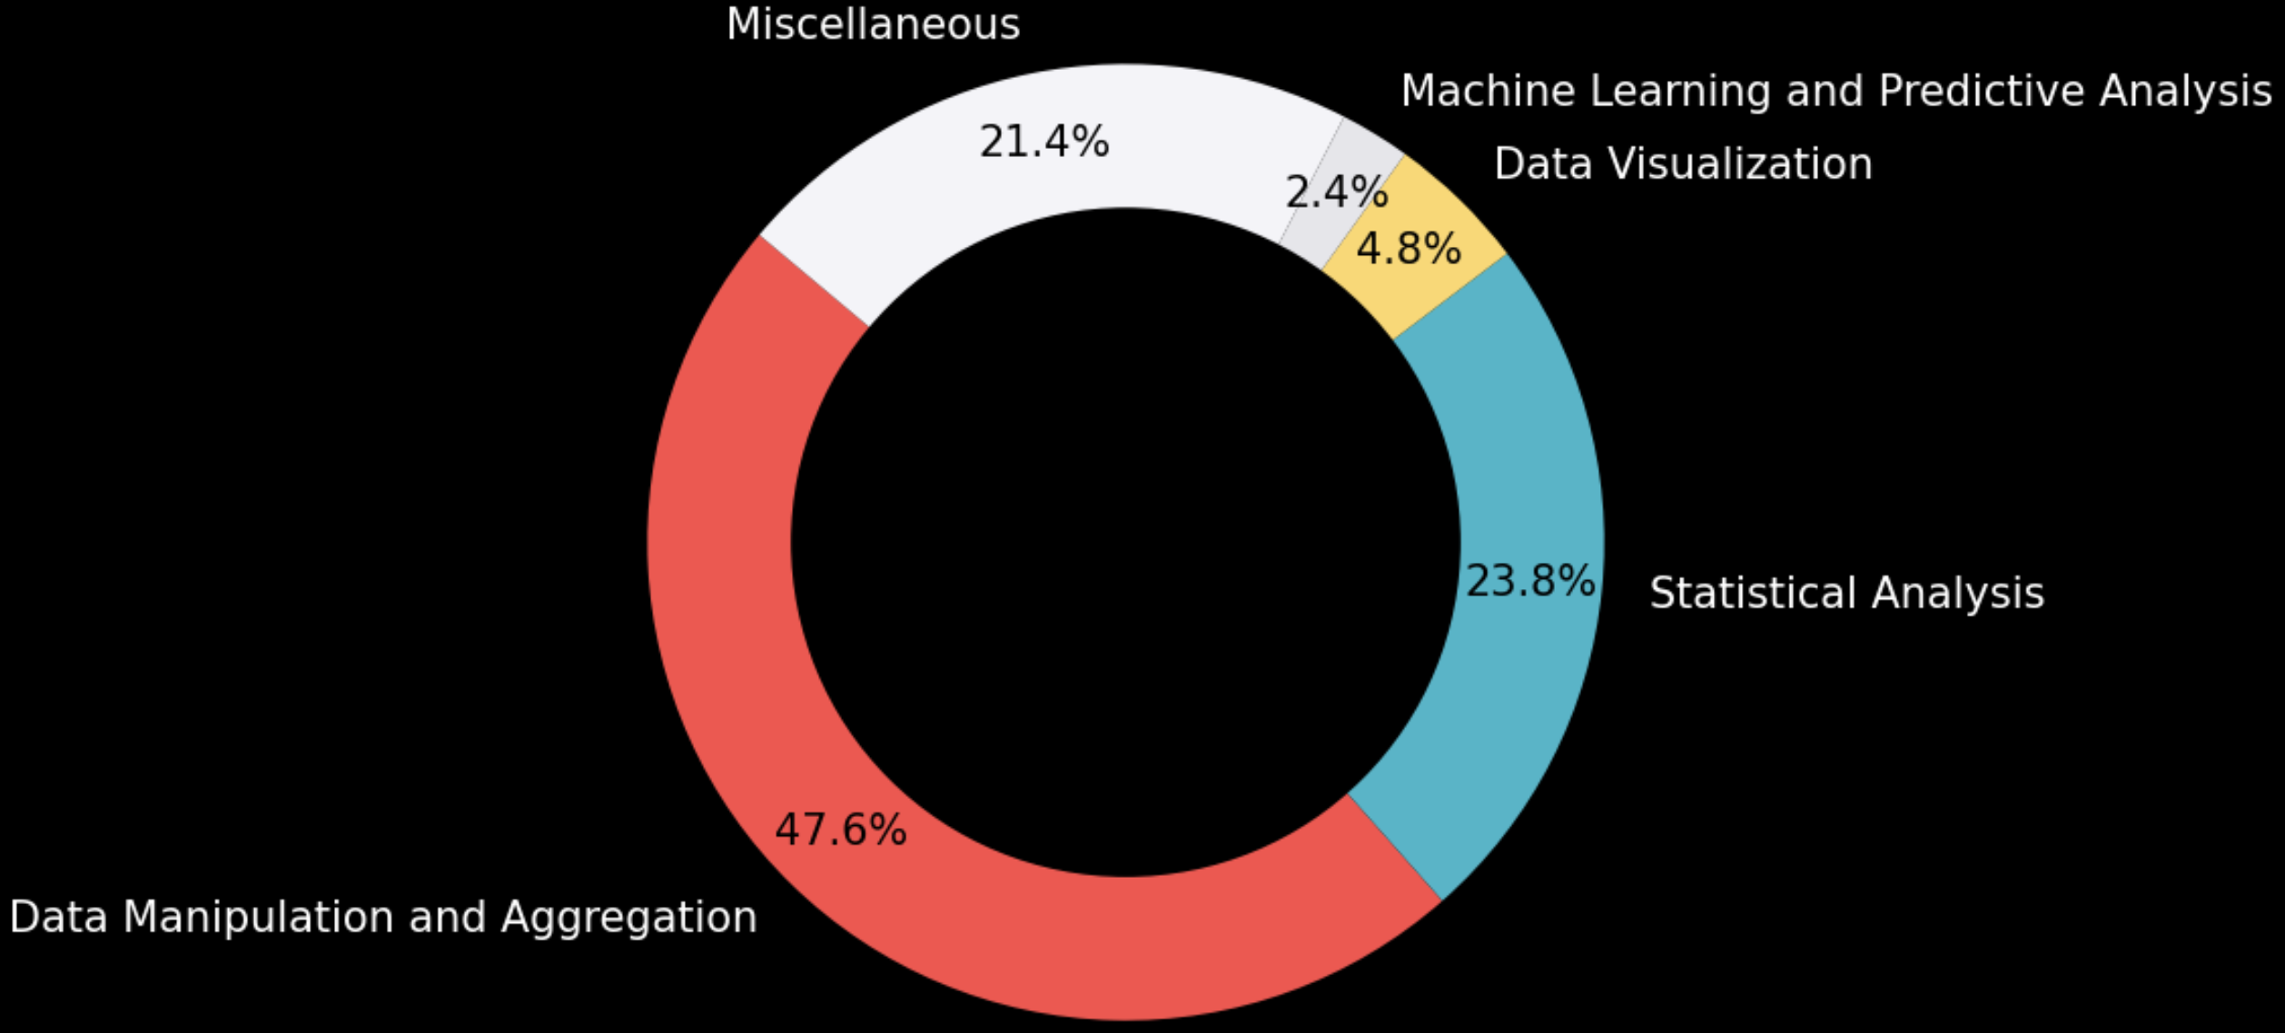
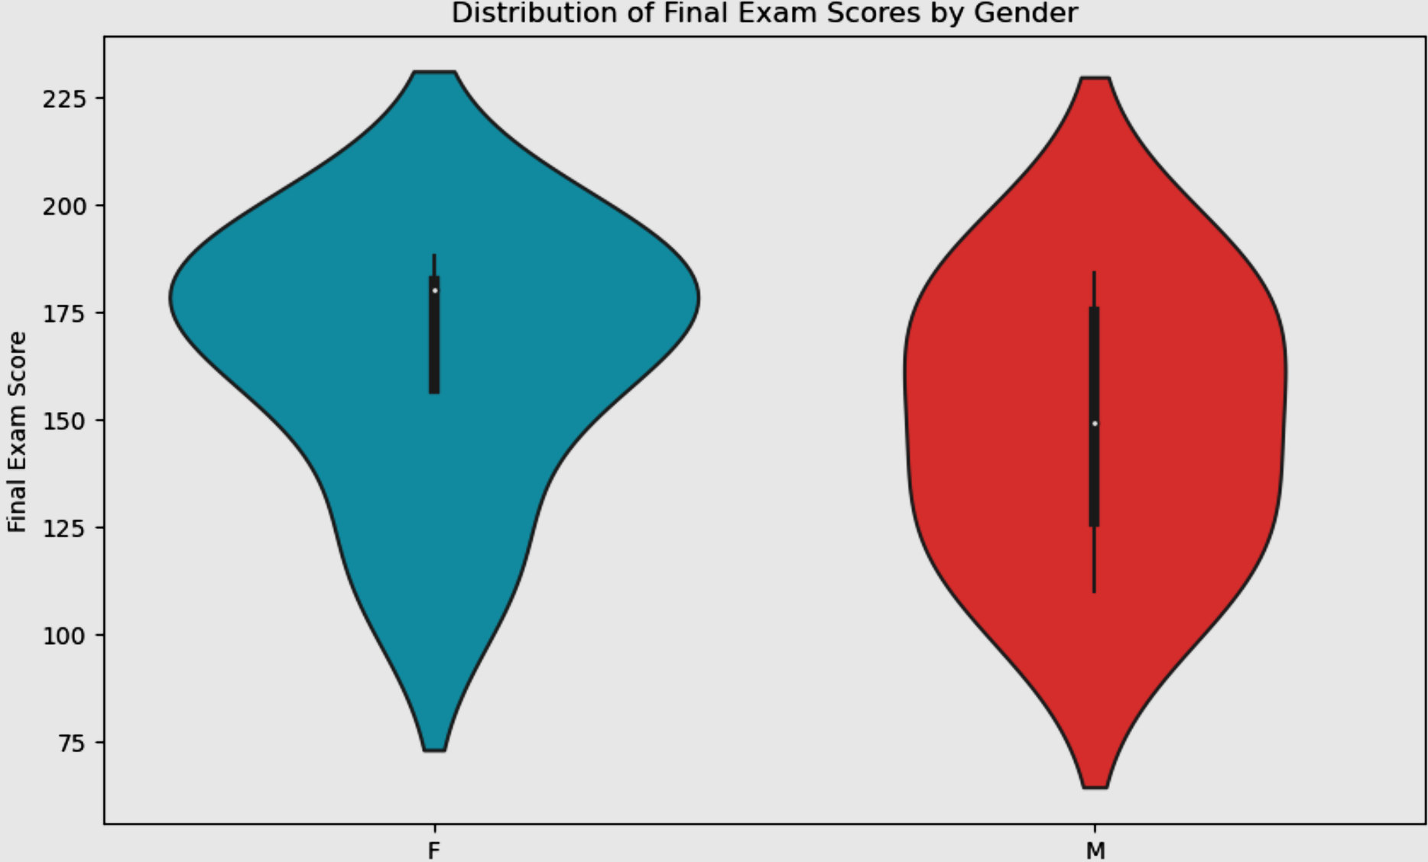
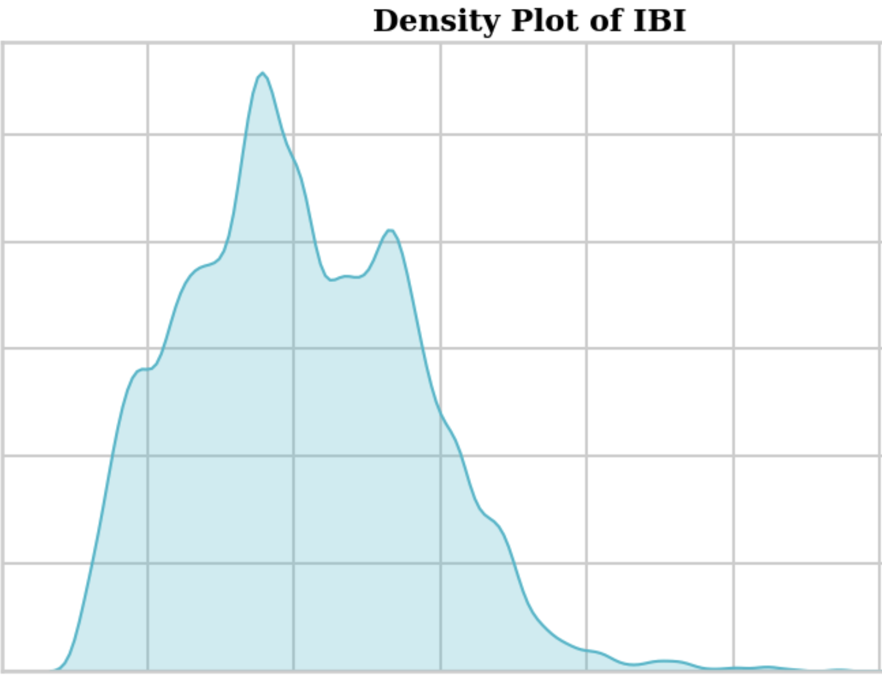
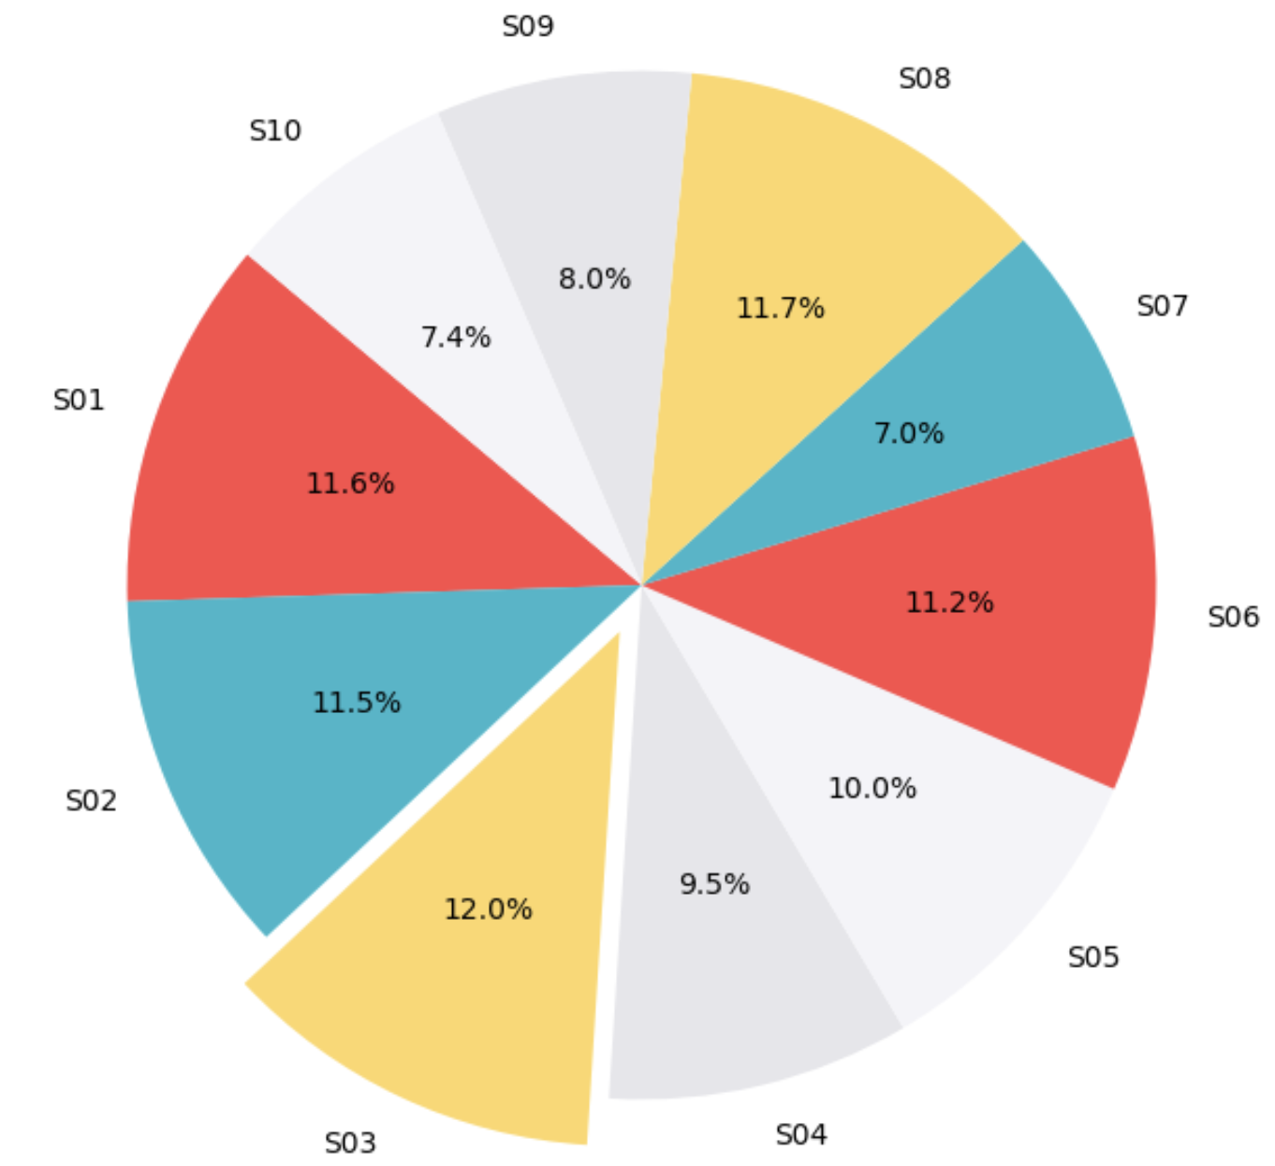
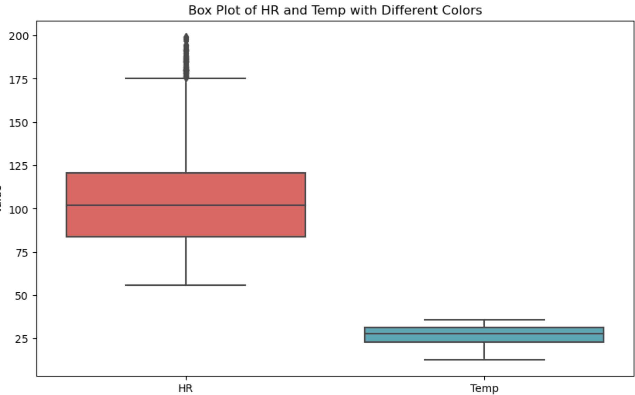
Hackathon Highlights
80 Questions to Code
Push Request
GitHub Desktop
Used pywaffle
Notes:
In a challenging week-long hackathon, our team tackled 80 Python coding questions to gain insights from dataset on exam stress, classifying them into 22 easy, 46 medium, and 12 complex tasks. The challenges we faced ranged from RMSSD calculation for stress quantification to merging data sheets for heatmap generation, among others.
Utilizing various libraries Pandas, NumPy, Scikit-learn, TensorFlow, and Keras, we've transformed raw data into clarity. We used GitHub for version control, which ensured seamless integration of our daily work. Out of the 80 questions, a larger number of questions required data manupilation and aggregation, followed by statistical analysis and data visualization questions.
Charts like violin charts, sunburst charts, join plots , box plots , wedged pie chart, and density plots were used to represent meaningful insights.

Slide 3
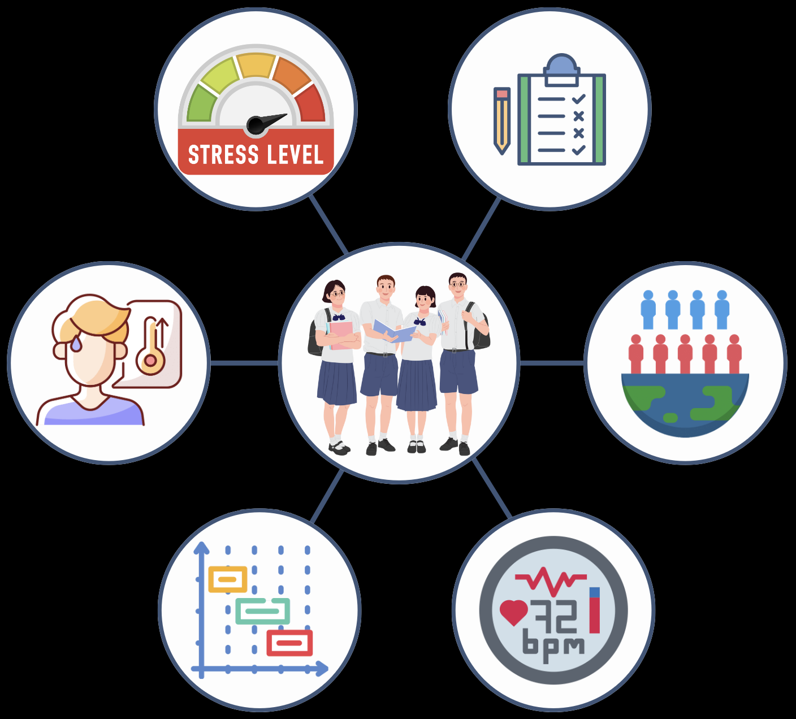



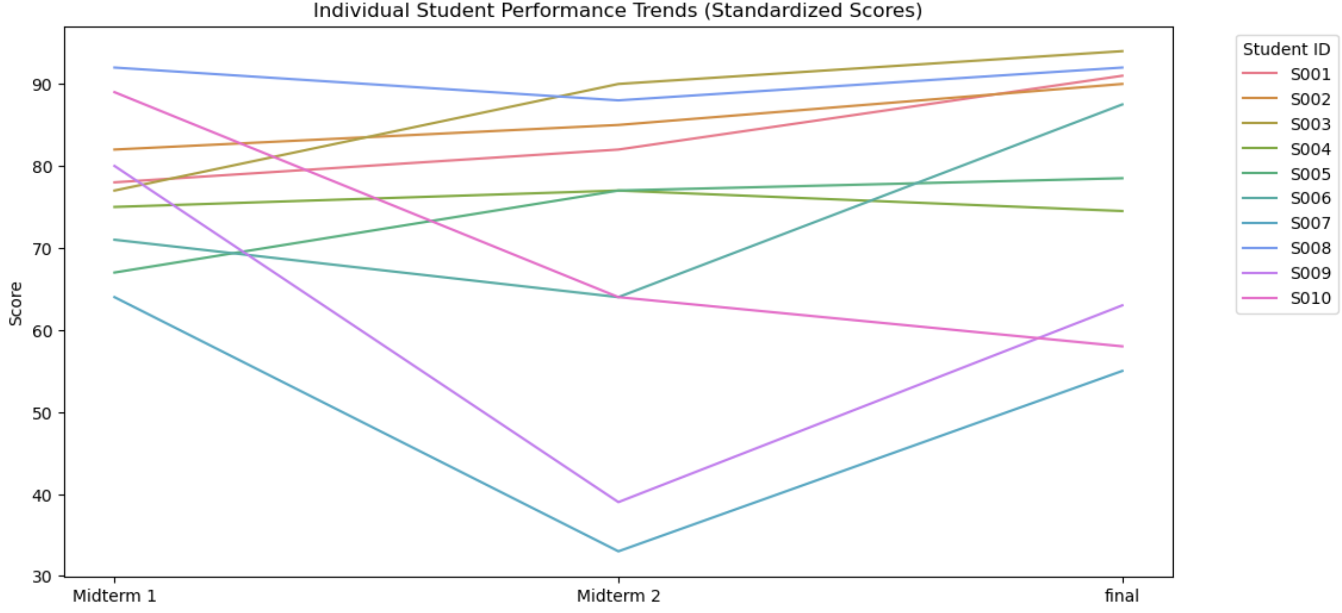


Workflow and Unique Contributions
EDA
Grades
Temp
Demography
Cognitive Champions
Data Pre-processing
Spent hours in coding the 80 questions,
daily code review and optimizing the code
IBI
HR
Understanding the dataset
Exploring Various Data Visualization Libraries in Python
Predictive Modelling and Machine Learning
- Implemented K – nearest neighbors clustering for identifying students with grade similarity
- ML Model for predicting final exam grade based on physiological signals. Comparison between linear regression and Random Forest.
- Support Vector Machine for classifying students by stress level
- Decision Tree Analysis for predicting final exam grades based on midterm grades
- Implemented LSTM using Tensorflow and Keras library to identify patterns in heart rate data during exams.
Deeper analysis on the
Dataset to gain meaningful insights
Used seaborn sns.lineplot
Notes:
Our analytical approach encompassed the following key points:
1. Data Preprocessing: We began with a thorough preprocessing of a new dataset consisting of grades, demographic information, and physiological signals from 10 students.
Our team tackled and solved 80 structured analytical questions, enhancing our understanding of the dataset.
After completing the initial questions, we conducted a deeper analysis on trends in exam scores and associated stress factors and explored new angle of analysis from the machine learning perspective. We have successfully implemented : K-nearest neighbors clustering to identify patterns in students' grades.
Comparison of Linear Regression and Random Forest for predicting final exam grades based on physiological signals.
Support Vector Machine for stress level classification.
Decision Tree Analysis for predicting final exam grades from midterm performances.
LSTM Networks: Utilized TensorFlow and Keras to analyze heart rate data and identify stress patterns during exams.

Slide 4
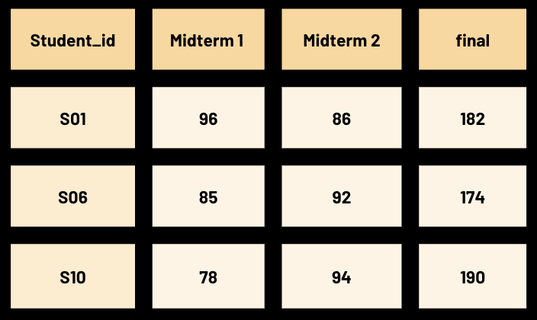
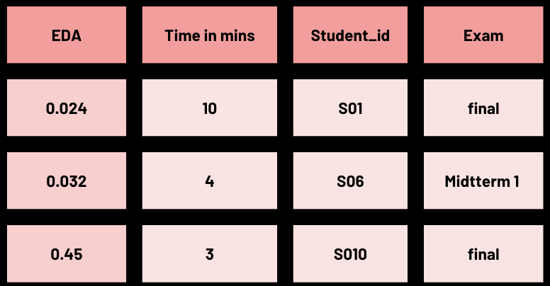

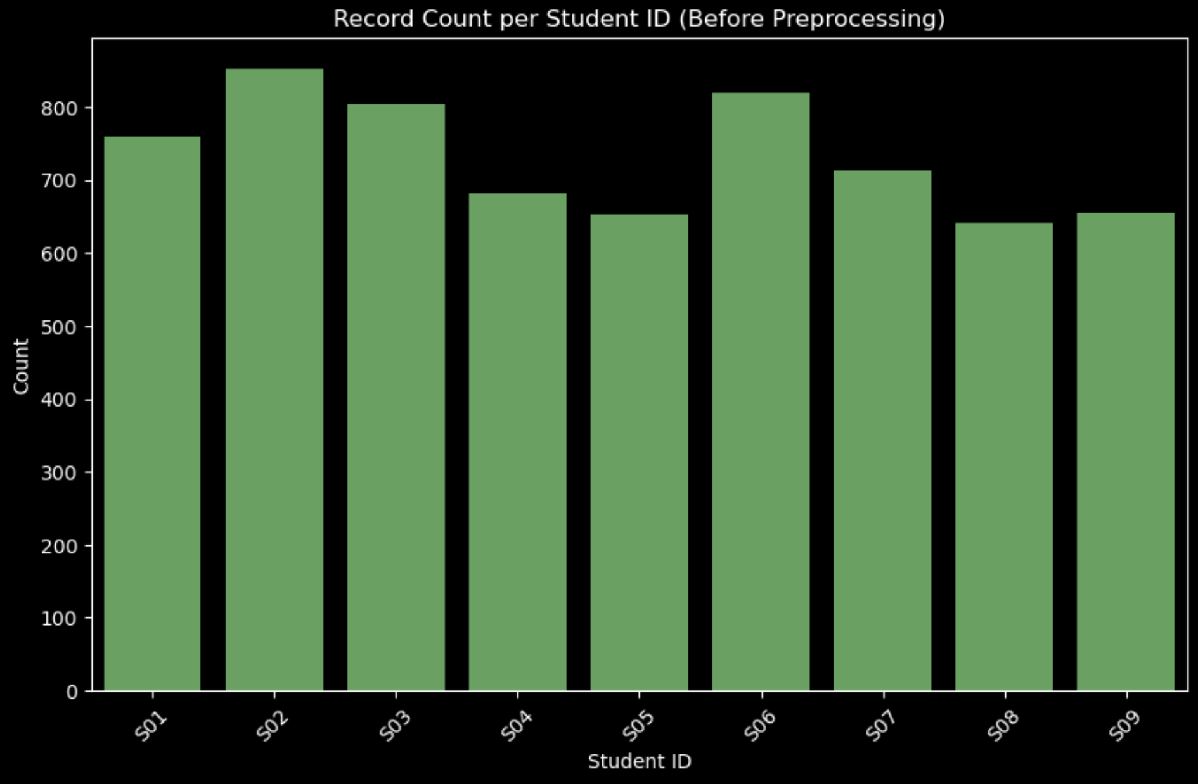

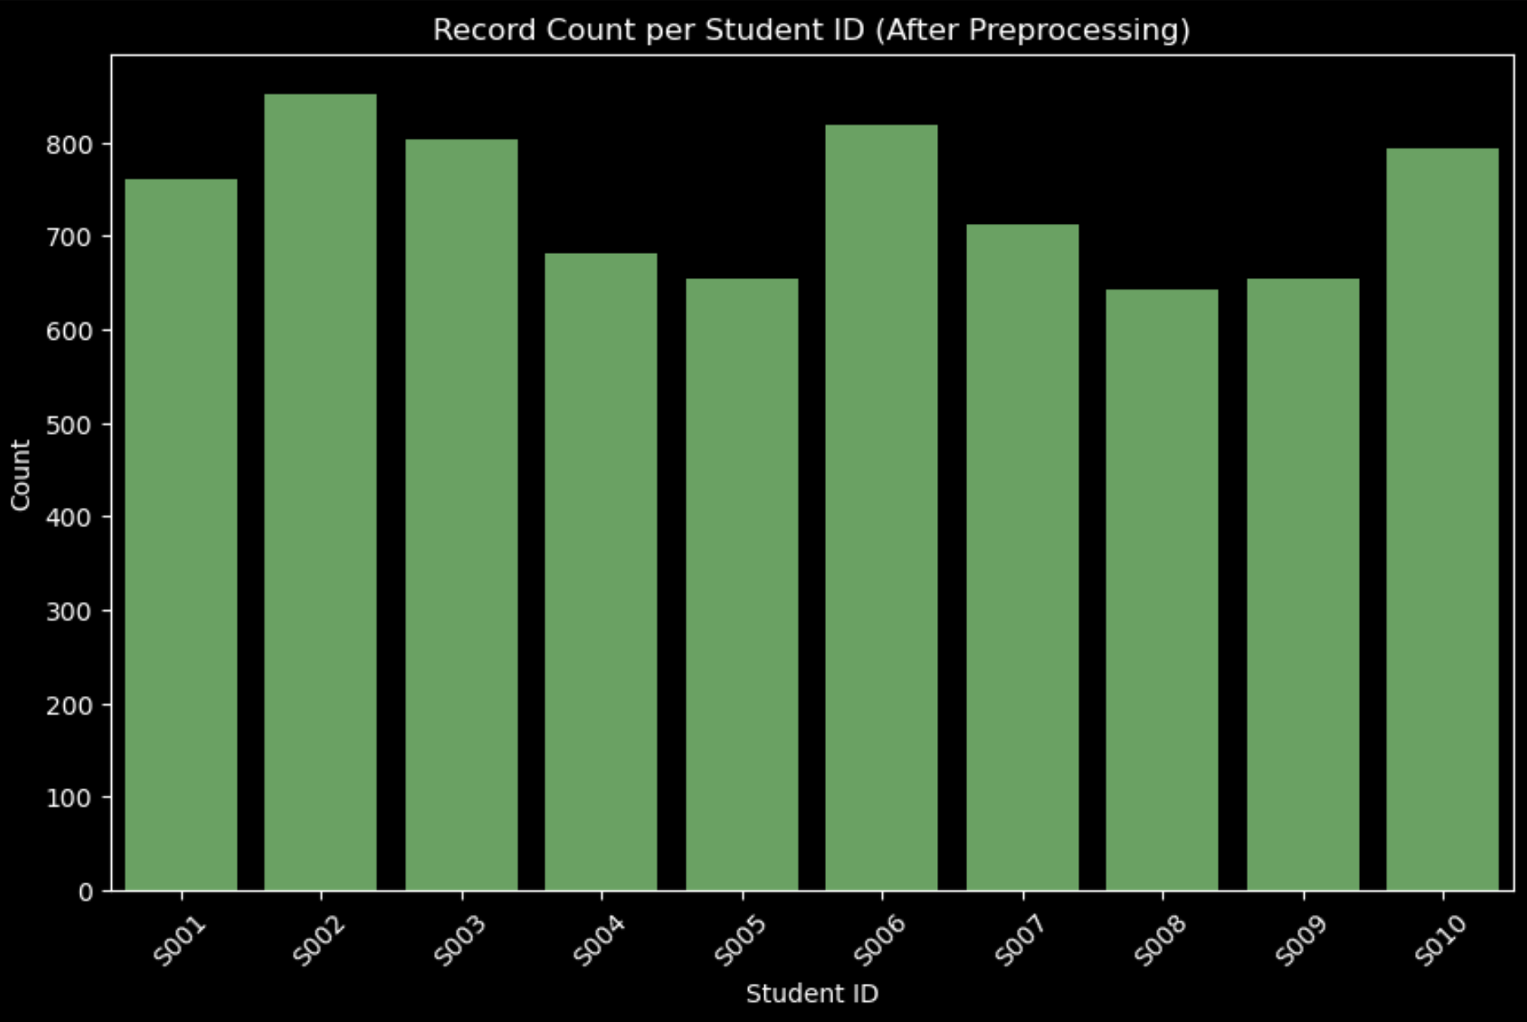
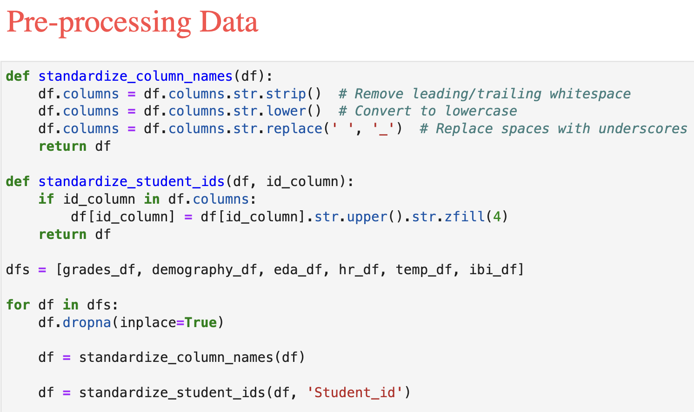
The first step to Insights..
merged_data = pd.merge(grades_data, hr_data, on= 'Student id', how='inner')
We want to analyze Stress performance analysis. By correlating EDA with grades, you can assess how stress levels might affect academic performance.
Grades_data
eda_data
Data In consistent
Student 10
Cleaning the data
Removing null values
Standardizing Column Names
Identifying and resolving inconsistencies
Ensures Data Quality and Integrity
Accurate Analysis
Reduces analysis complexity
Notes:
in our analysis to find how stress and academic performance are related , we recognized the need to correlate Electrodermal Activity (EDA) with grades. This required merging of EDA and grade data from separate sheets. However, a direct merge proved insufficient, as it led to the exclusion of student s10's records—a prime example of the pitfalls in raw datasets.
Why the exclusion? Discrepancies in labeling across the sheets. It was imperative to standardize these identifiers to maintain data integrity. Additionally, we addressed NaN values that could skew our analysis and standardized column names for uniformity.
Post-cleanup, our merge was complete, and student s10's data was recovered, ensuring our dataset's accuracy and the validity of our subsequent analysis.

Slide 5
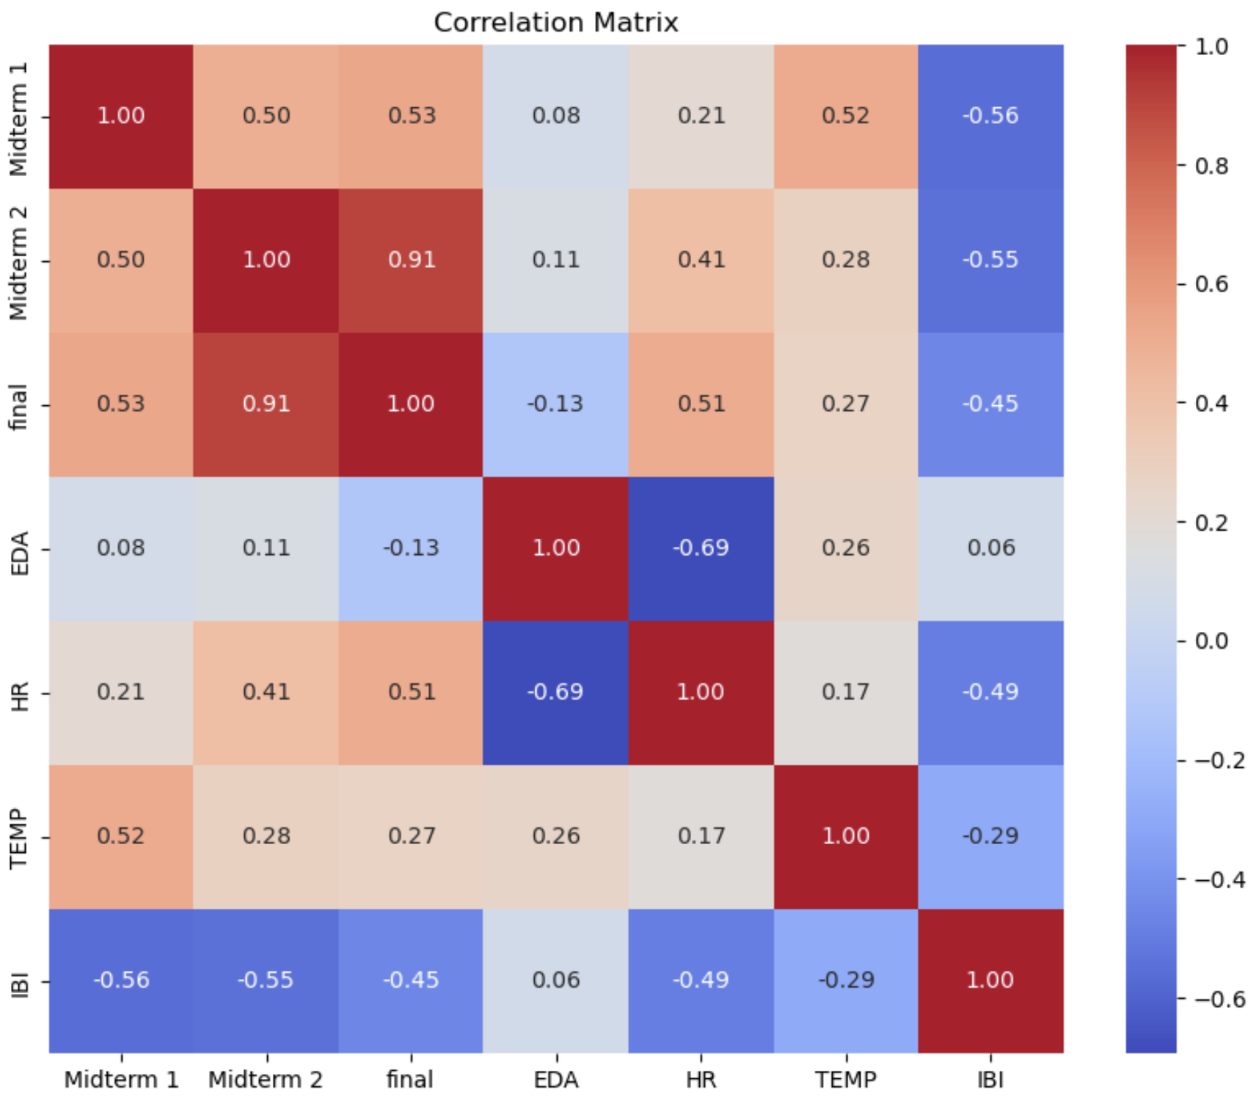
Learnings | Limitations | Future Scope
Explore datasets and study research papers – Physionet | Google Scholars
Apply visualization techniques, frameworks – Grammar of graphics using seaborn objects | Matplotlib | plotly |pywaffle
Bring novelty in digging insights from various sheets of the dataset
Pre-process data – Handle Nan, standardization of columns
Prepare data for ML – Train-test split | sampling | stratification
Conduct thorough data analysis using statistical & predictive analytics – Stat models | ML
Feature Engineering – One hot encoding | Column transformer | Feature selection
Explore various machine learning algorithms – Logistics regression | K-Nearest neighbors
Build Data pipelines
Evaluate Model performance – Confusion Matrix | ROC curve | Accuracy | Cross validation
LIMITATIONS OF DATASET
Very less sample size. Good for exploratory and statistical analysis, but difficult to train ML and LSTM models.
Simpler models like Linear Regression and decision tree will outperform due to overfitting.
Limited in features
FUTURE SCOPE
Data Collection
Model Exploration
Feature Engineering and temporal analysis
Notes:
the dataset was limited in features, which naturally restricts the depth of analysis and model sophistication one can achieve. the dataset was limited in features, which naturally restricts the depth of analysis and model sophistication one can achieve.

